Slide 1

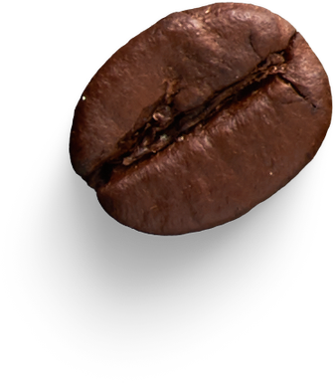
www.ClearAnalytics.com
Bright Coffee Shop
COFFEE SHOP ANALYSIS REPORT : Data Driven Decisions for the CEO
Presented By Sharon Mathebula
Data Scientist
Data Entrepreneur

Slide 2


www.clearanalytics.com
Content
Overview
Operational Systems
Insights & Findings
Strategic Advice
Implementing Plan
Questions & Answers
by Sharon M

Slide 3
www.clearanalytics.com
Overview
End-to-end analysis of six months of transactional data across three store locations, generating R698812.33, from 149116 sales with an average order value (AOV) of R697319,18.
The study uncovers key revenue trends, compares weekday and weekend performance, and identifies top-performing products and categories to determine when, where, and what drives sales.
Raw data was transformed into insight-driven metrics, including Average Order Value (AOV), seasonality, and time-based patterns.
The analysis highlights the key drivers of revenue and customer behavior, providing actionable insights to improve operational efficiency and support revenue growth.
Operating Systems
Raw Data ingestion into Databricks
Data quality checks (nulls & duplicates)
Data Processing
Feature engineering (time & behavioral features)
Trend and segmentation analysis
Dashboard development for visualization using Excel
Insights and business recommendations
by Sharon M

Slide 4
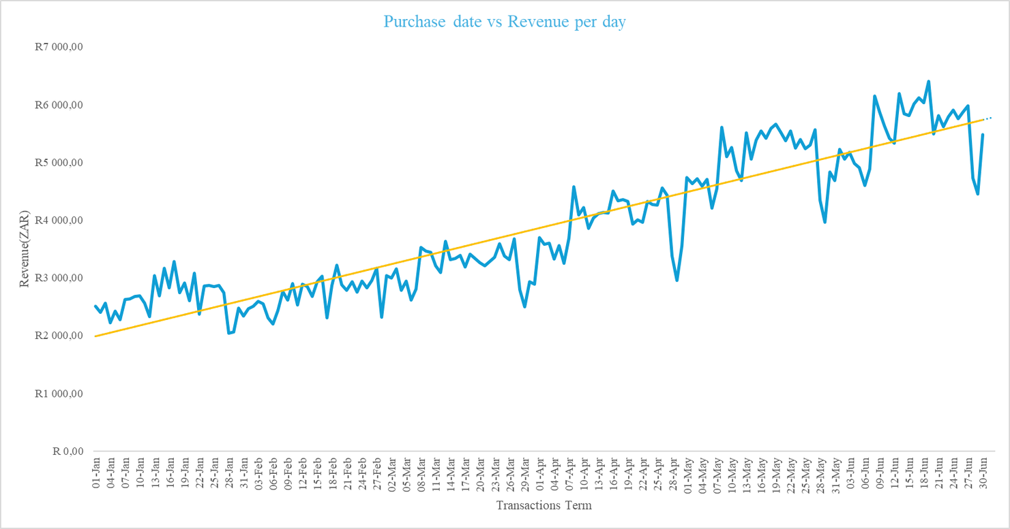
www.clearanalytics.com
Insights &Findings
Daily Performance Throughout 6 months period of Transaction
The revenue increases over time.
The daily revenue has sharp ups & downs (demand is not stable day to day).
Quick periodic Drops every month end and pick ups.
Stronger Performance in June.
by Sharon M

Slide 5
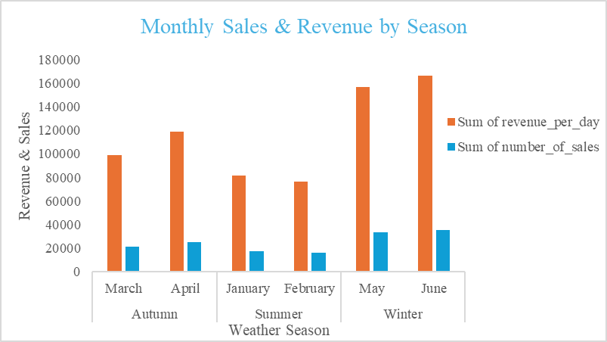
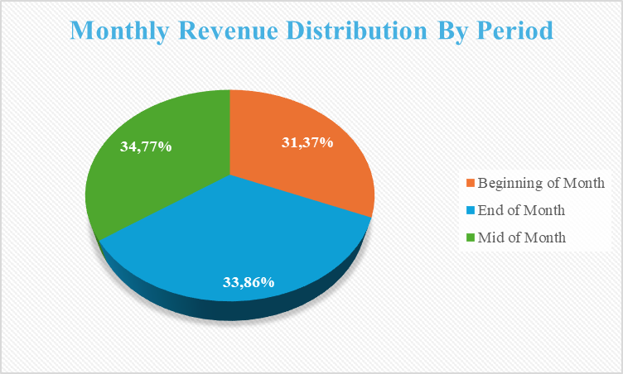
www.clearanalytics.com
Insights &Findings
Monthly & Seasonal Performance
Winter drives the highest revenue high demand of hot beverages. Hence June is the peak month.
Autum shows strong but moderate performance.
Summer is the weakest season. Low demand of hot beverages
Strong correlation between sales & revenue; growth driven by number of transactions rather than price increases
Revenue & sales growth overtime indicates seasonality pattern
Mid month drives the highest revenue generation
In overall, the beginning of month is weakest. Customers may be prioritizing bills.
Month end very close to mid month, possible influence of discount cycles or stock clearance.
Thus, a quick pick of revenue after a slight drop i.e., purchase date vs revenue.
by Sharon M

Slide 6
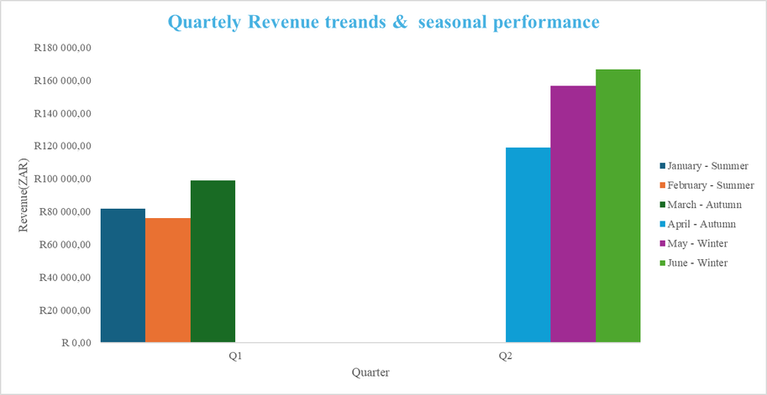
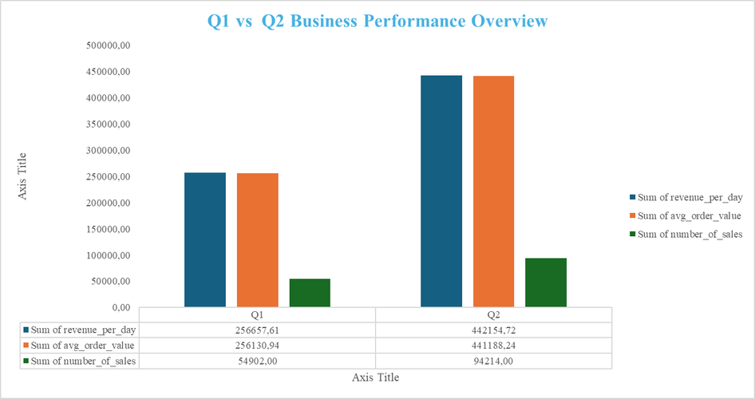
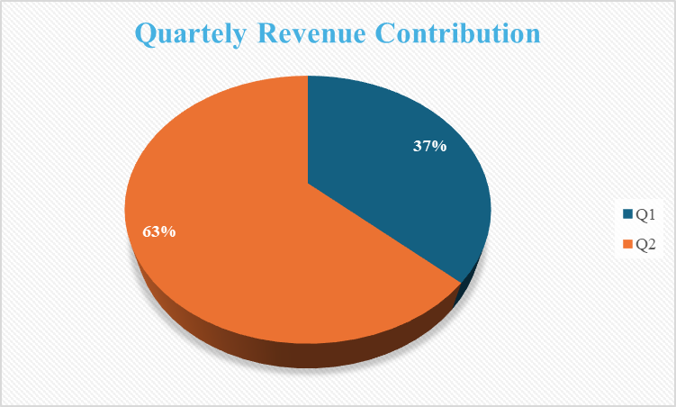
www.clearanalytics.com
Insights &Findings
Quarterly Performance
March(Autum) performs best in Q1 suggesting strong latter quarter sales.
Q2 significantly outperforms Q1 across all key metrics , sales distribution, revenue contribution average order value with June (Winter) being the highest revenue month overall.
Winter months generates the highest revenue.
Revenue contribution shows a strong shift with Q2 contributing 63% of total revenue compared to Q1 at 37%.
Number of sales nearly doubled in Q2 showing higher customer activity and demand for hot beverages.
Average order value increased in Q2 indicating customers are spending more per transaction.
by Sharon M

Slide 7
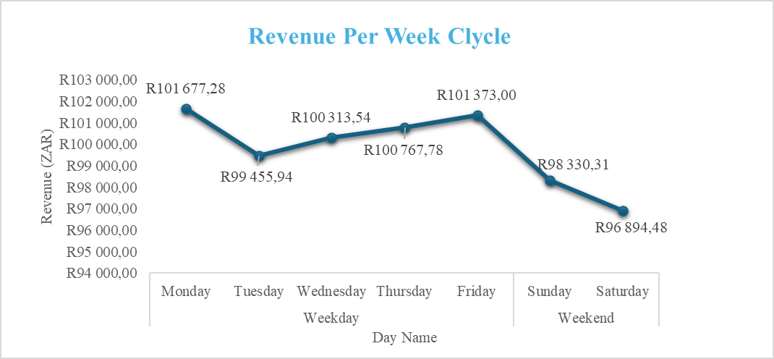
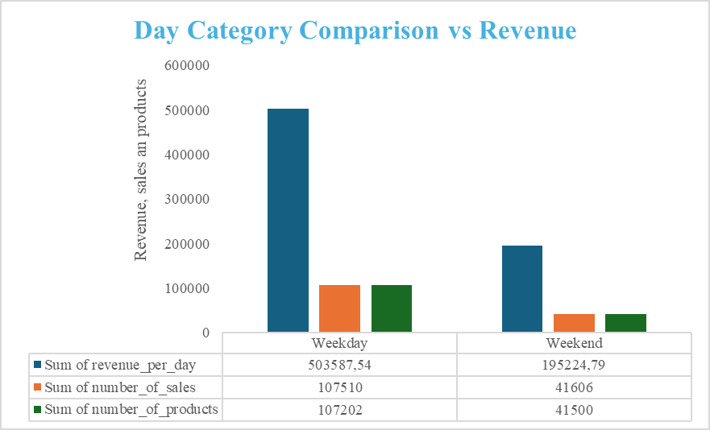
www.clearanalytics.com
Insights &Findings
Weekly Trends & Weekly Segments
Monday shows the peak performance and closely followed by Friday.
The trend shows a drop later Monday to Tuesday followed by a steady recovery through Friday before dropping off on weekend
Weekdays generates significant activity.
Weekdays account for most of the revenue (approximately R503587,54), order volume (around 107510) and sells about 107202 products, which is more than double the figures for the weekend (approximately R19524,79 in revenue, 41606 orders and about 41500 products sold).
The notably higher activity during weekdays suggests that operations, staffing, and inventory should be adjusted to prioritize weekday demand.
by Sharon M

Slide 8
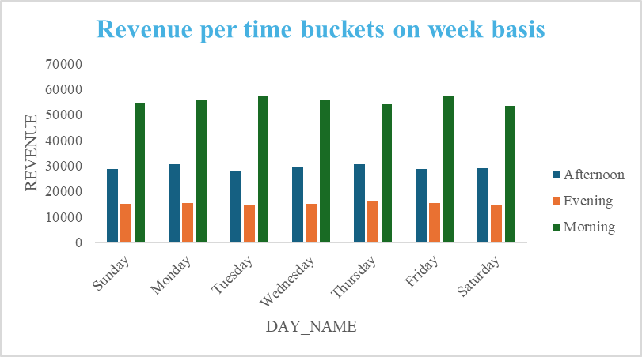
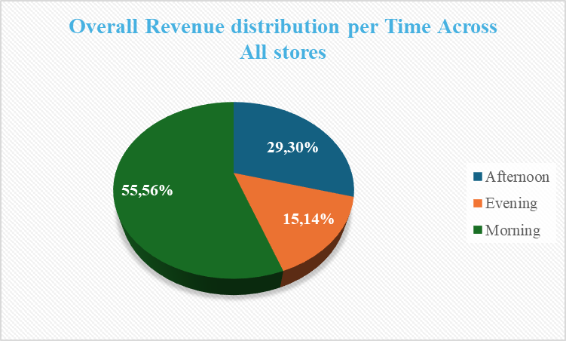
www.clearanalytics.com
Insights & Findings
Weekly Performance & Time Segments
Morning throughout the weeks is the primary revenue engine, consistently generating 3x to 5x most revenue than any other time.
Tuesday and Fridays are the strongest performers for morning sales .
Afternoon is the second tier of income, contributing a steady ~R25 000 to R30 000 daily.
Evening is the weakest performing period, typically ranging between R10 000 to R13 000 throughout the weeks
Morning accounts for most of the revenue (~55,56%), more than the combined Afternoon and Evening shares
Afternoon contributes roughly ~29,30% while Evening is the smallest segment (~15.14%), indicating a strong morning-focused demand pattern.
by Sharon M

Slide 9
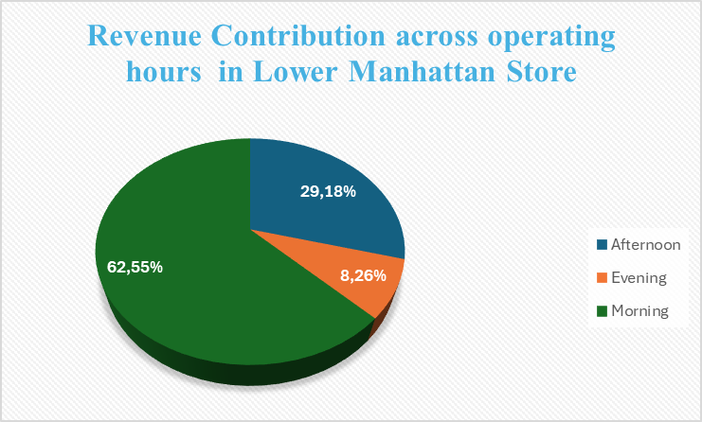
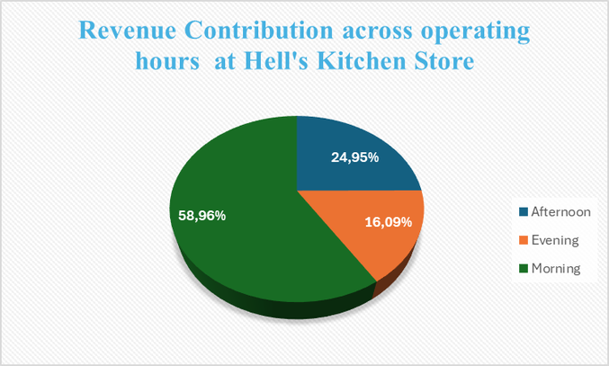
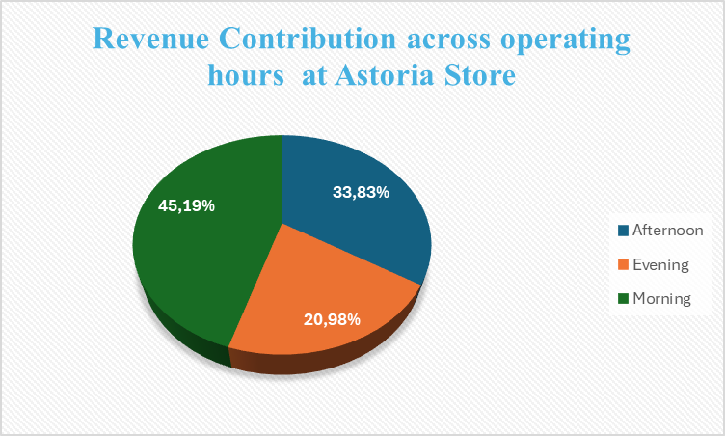
www.clearanalytics.com
Insights &Findings
Store Performance & Time Segments
Lower Manhattan contributes ~62,55% of the revenue to the overall 55,56% in the morning.
Hell’s Kitchen contributes ~58,96% of the revenue to the overall 55,56% in the morning.
Astroria crontibutes ~45,19% of the revenue to the overall 55,56% in the morning.
In the evening Astoria performs the best, contributing ~20,98% than hell’s kitchen which contributes ~16,09% and Lower Manhattan which contributes ~8,26% as the worst performing store in the evening.
by Sharon M

Slide 10
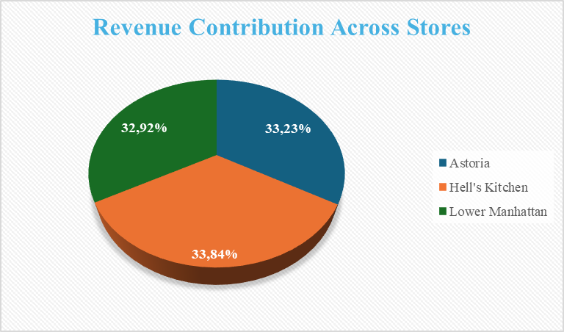
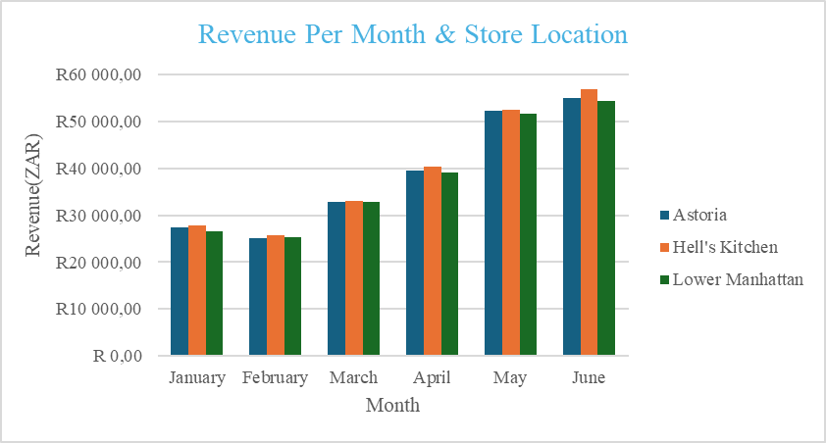
www.clearanalytics.com
Insights &Findings
Store Performance & Time Segments
Hell’s Kitchen contributes the highest revenue by ~33,84% followed clossely by Astoria which contributes 33,23%
Lower Manhattan contributes the least to overall Revenu by 32,92%
Hell’s Kitchen shows the highest revenue per month, particularly in winter (May and June) where there is high demand of hot beverages.
Lowere Manhattan shows the weakest revenue pe month. not even a single month it was the best performing
by Sharon M

Slide 11
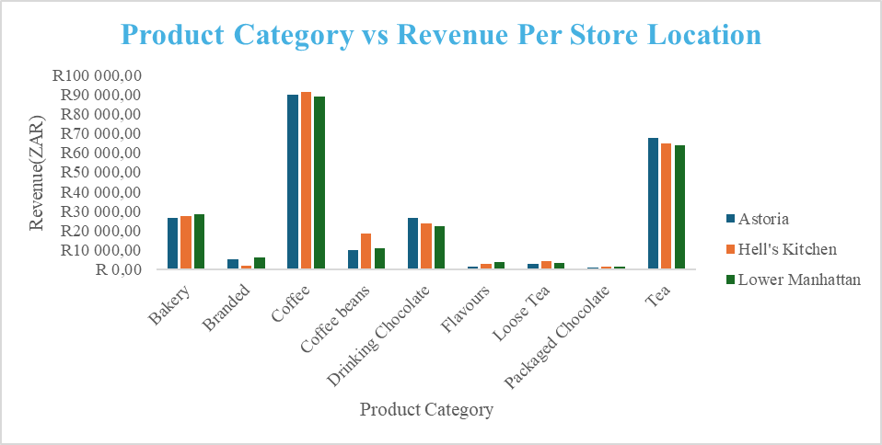
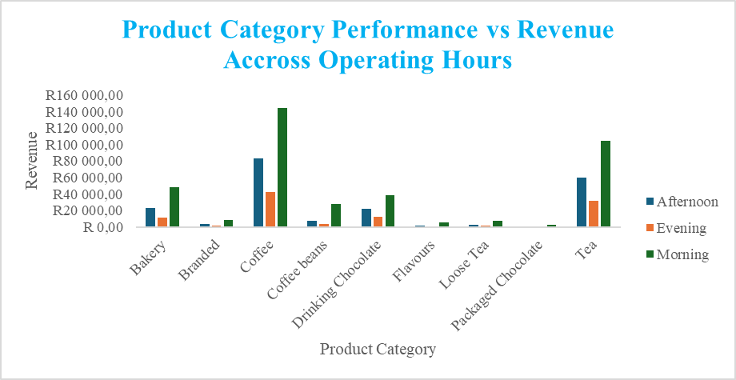
www.clearanalytics.com
Insights &Findings
Store Performance & Time Segments
Coffee is the highest revenue generator across all locations and operating hours, significantly outperforming other categories.
Tea and Bakery items contribute notable revenue, though much less than coffee across all locations and operating hours.
Items category like Loose Tea, Packaged Chocolate, and Drinking Chocolate show minimal revenue across all stores.
Afternoon shows a decrease in Coffee sales but maintains steady interest in Tea and Coffee Beans.
Evening is generally the lowest revenue period across most categories.
Packaged chocolate category contributes no revenue in the afternoon or evening.
by Sharon M

Slide 12
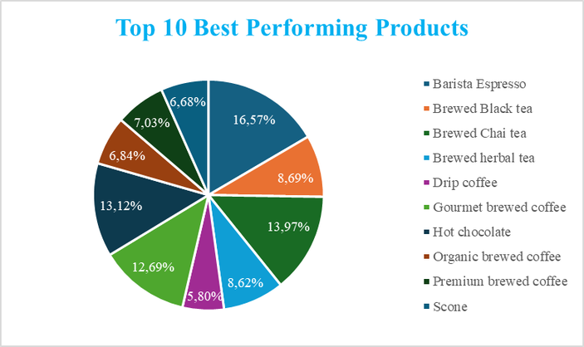
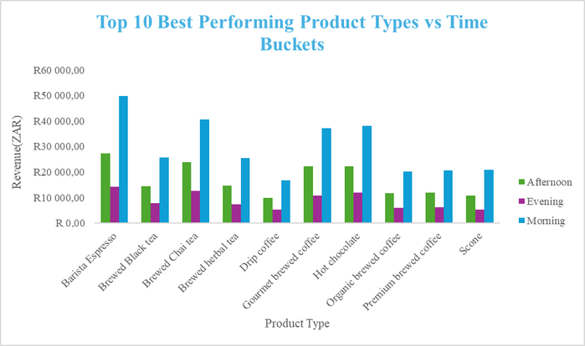
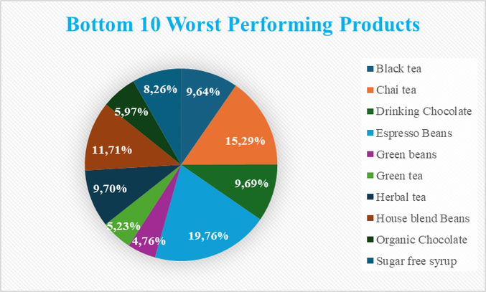
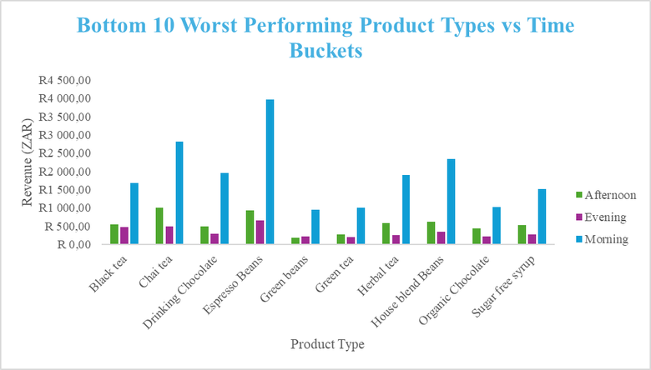
www.clearanalytics.com
Insights &Findings
Product Performance & Time Segments
Lowest Performing Products
Barista Espresso is the top-performing product, accounting for 16.57% of the distribution among the top 10 products.
Following Barista Espresso, the next highest performers are Hot Chocolate (13.97%) and Gourmet Brewed Coffee (13.12%).
Barista Espresso maintains high revenue (ZAR) across operating periods, peaking at over R40,000 in the morning.
Lowest Performing Products
The pie chart identifies green beans (4,76%) and green tea (5.23%) among the least performing items.
by Sharon M

Slide 13
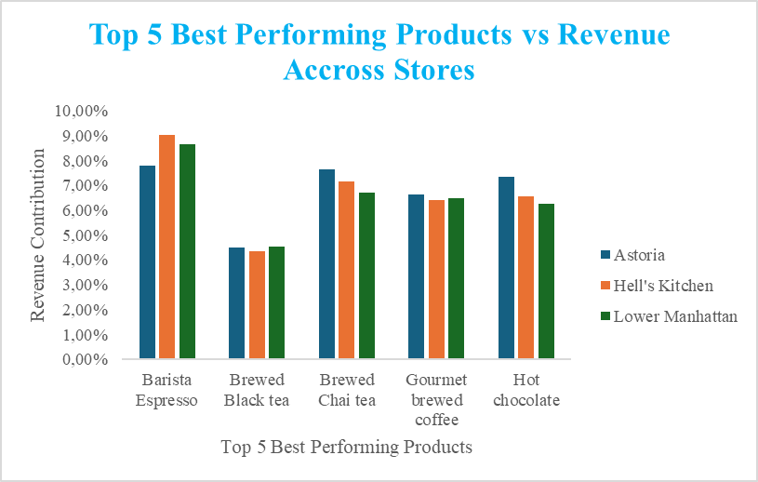
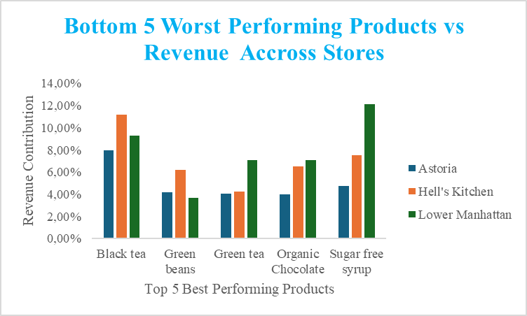
www.clearanalytics.com
Insights and Findings
Product Perfomance & Store Location
Barista Espresso is the top revenue contributor across all three stores, with Hell’s kitchen showing the strongest performance for this item.
Gourmet Brewed Coffee, and Hot Chocolate follow.
Store Trend: Generally, Astoria leads in revenue for other products besides Barista Expresso, compared to the other two locations.
Green beans is worst performing product across all stores followed by green tea , where most of its revenue comes from Hell’s Kitchen suggesting these might be niche items or candidates for better promotion.
Sugar-free Syrup is low overall; it has a significant spike in Lower Manhattan (green bar) compared to its performance elsewhere.
by Sharon M

Slide 14
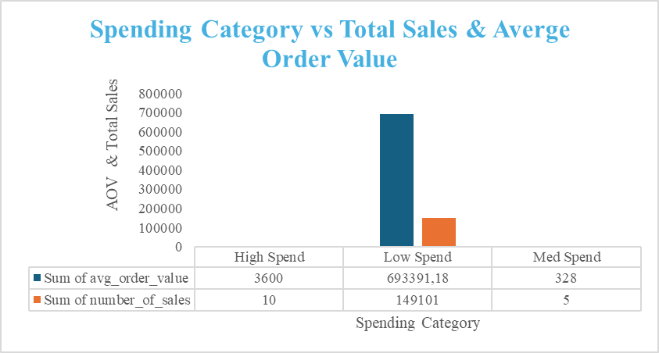
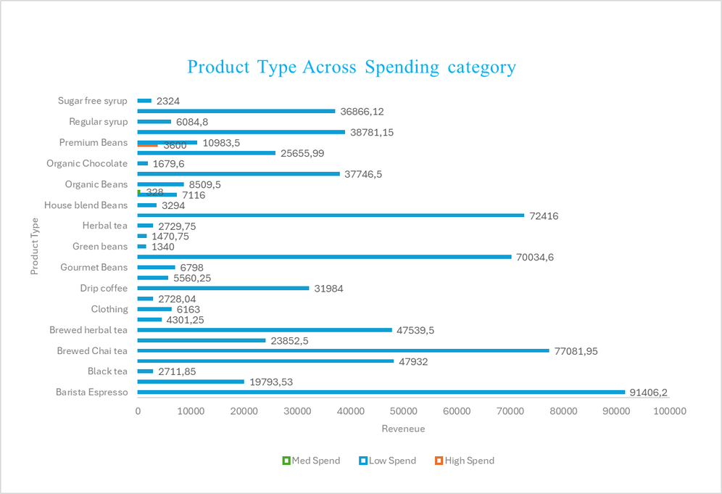
www.clearanalytics.com
Insights &Findings
Pricing & Spending
Low Spend dominates in terms of total sales, with a value of 693,391.18. Interestingly, this category has a very low Average Order Value (around 14,910), indicating a high volume of small-value transactions.
High Spend category represents the inverse; it has a very high Average Order Value (3,600) but a relatively small portion of total sales (10), indicating that customers are not buying premium beans which is expensive than the one sold at lowest/lower price. This indicates that there is a same product at different pricing and or two different product with same name.
Med Spend shows minimal contribution to the revenue , with very low values for both metrics compared to the other groups. Houseware product type in medium spend might be like the one at low price also indicating that customer prefer purchasing the one at lower price and or two different product with same name.
by Sharon M

Slide 15
www.clearanalytics.com
Implementation Plan
Home
Service
About Us
Contact
1. Stabilize Revenue Fluctuations
Introduce subscriptions or prepaid models for steady income
Use targeted promotions on low-demand days
Example: Monthly coffee subscriptions or weekday discounts (e.g., Tuesday deals).
2. Address Month-End & Early-Month Drops
Launch value-driven early-month promotions
Use month-end urgency offers
Introduce pre-sales or vouchers
Example: Discounted breakfast combos early and “last 3 days” sales at month-end.
3. Maximize Peak Season Performance (Winter/June)
Expand seasonal, high-margin products (hot chocolate & Barista espresso)
Use bundling to increase AOV
Reinvest in top-performing products and channels
Example: Limited-time winter drinks bundled with pastries.
4. Improve Slow Period Performance (Summer/Q1)
Introduce cold beverages and summer items
Target new segments (students, remote workers)
Host events to drive traffic
Example: Iced drinks and a work-friendly café setup with Wi-Fi.
5. Optimize Time-of-Day Sales
Maintain morning efficiency (staffing, speed)
Introduce afternoon promotions (Happy Hour)
Develop evening-specific offerings
Example: 1–2 PM discounts or evening coffee-and-pastry deals.
6. Increase Average Order Value (AOV)
Create bundles and combo deals
Train staff on upselling and cross-selling
Offer spend-based incentives
Example: Add a pastry for a small extra cost or rewards for spending above a threshold.
by Sharon M

Slide 16
www.clearanalytics.com
Home
Service
About Us
Contact
Implementation plan
7. Optimize Product Mix
Promote top-selling items
Bundle or reposition low-performing products
Remove consistently weak items
Example: Pair low-selling tea with popular snacks or rebrand it as premium.
8. Improve Operational Efficiency
Schedule staff based on peak periods
Adjust inventory to high-demand products
Reduce costs during low-traffic times
Example: Increase staffing on busy days and reduce weekend overhead if needed.
9. Strengthen Customer Retention
Implement loyalty programs
Use personalized marketing (SMS/email)
Encourage reviews and referrals
Example: “Buy 3 for 2, get 1 free” or personalized discounts.
10. Leverage Customer Segmentation
Increase spend from low-value, high-frequency customers
Offer premium experiences for high-value customers
Example: Bundle deals for frequent buyers and VIP perks for top spenders.
11. Address Duplicate or Similar Products
Conduct a product and pricing audit
Identify and differentiate or rename overlapping products
Analyze customer price sensitivity
Example: Clearly distinguish between standard and premium products through branding, features , or packaging.
by Sharon M

Slide 17
www.clearanalytics.com
Home
Service
About Us
Contact
Implentation Plan
Short-Term (0–3 Months)
Align staffing and inventory with peak demand periods (mornings & weekdays)
Introduce targeted promotions during low-performing periods
Prioritize top-performing products
KPIs:
+10–15% increase in daily revenue during peak hours
+5–10% increase in evening sales
Reduction in stock-outs for top products
Medium-Term (3–6 Months)
Launch seasonal campaigns (winter focus)
Implement customer segmentation (AOV-based)
Introduce bundling and pricing strategies
KPIs:
+10% increase in Average Order Value (AOV)
+15% growth in seasonal product sales
+8–12% increase in customer retention / repeat purchases
Long-Term (6+ Months)
Develop sales forecasting models
Implement data-driven marketing strategies
Expand high-performing products and store strategies
KPIs:
Forecast accuracy ≥ 85%
+15–20% overall revenue growth
Improved customer lifetime value (CLV)
by Sharon M

Slide 18
www.clearanalytics.com
Home
Service
About Us
Contact
Thank You
“Success will be measured through clear performance metrics, ensuring all strategies deliver measurable business impact.”
Question & Answer
by Sharon M

